Slide 1
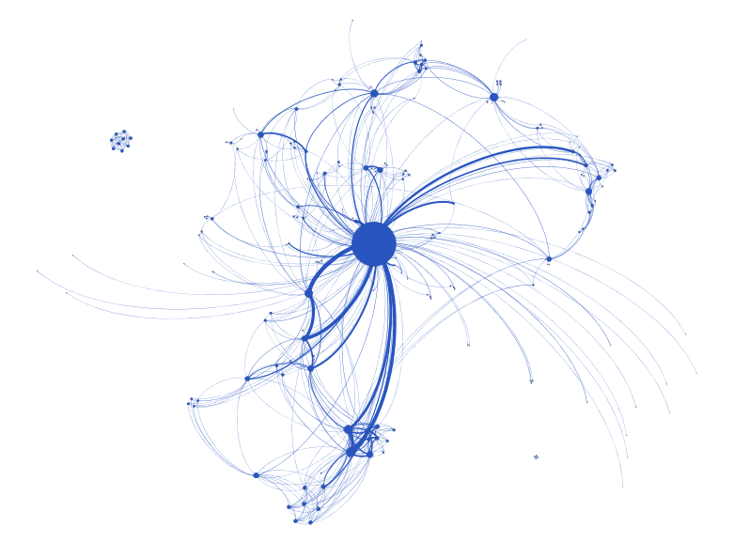
Scientific Collaboration through the lens of
Social Network Analysis
A case study using the
2015 Canadian Aquaculture R&D Review
C. Mimeault and M. Williamson
Ottawa Graph Meetup
July 2017
(tentative)

Slide 2
Scientific collaboration
Science advice relies on knowledge generated by a large community of researchers
New investments are being used to increase scientific collaboration to foster and leverage important partnerships
Increasing collaboration represents an intervention in an existing community which can be data driven and informed by science
DRAFT

Slide 3
Social Network Analysis
Science that studies the structure of communities providing tools to describe and measure collaboration
A network is a collection of points (nodes) joined together in pairs by lines (edges) (Newman, 2010)
For example, applying those concepts, collaboration between DFO, UBC and UNB could be modelled as follows:
Conceptualizing available data in the form of a network allows to apply multiple social network analytical tools
UBC
DFO
UNB
DRAFT
Notes:
Newman, M.E.J. Networks. An introduction. Oxford University Press, 772 pages.

Slide 4
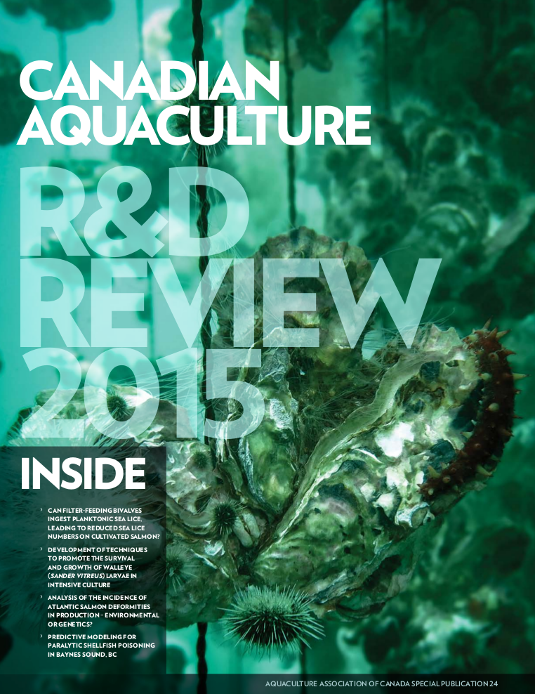
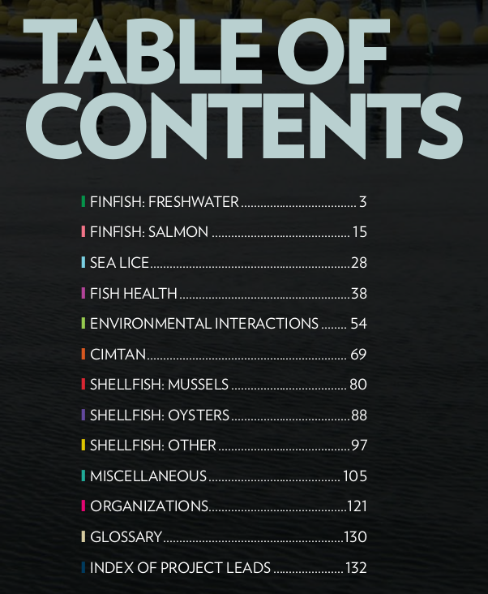
Case Study
http://www.dfo-mpo.gc.ca/aquaculture/sci-res/rd-eng.htm
DRAFT

Slide 5
Aquaculture R&D Reviews
Every two years since 2007, the Aquaculture Association of Canada publishes, in partnership with Fisheries and Oceans Canada, a compendium of the on-going aquaculture research and development projects in Canada
Projects include governmental, academic, industry and non-governmental organizations
The Aquaculture R&D Reviews provide an overview of the Canadian aquaculture research community over the last decade
Extracting project details from those documents creates a dataset amenable to a variety of analytical techniques including descriptive statistics and social network analysis
DRAFT

Slide 6
Methodology
Collaboration was defined as two or more organizations either :
  working on a given project, i.e. listed as project lead, project team or collaborators; or
  funding a given project, i.e., listed as funders or co-funders
For each project included in the 2015 Aquaculture R&D Review, specific variables (category, title, funded by, co-funded by, project lead, project team, collaborators) were extracted into a structured, consistent and parsable data format (yaml)
A series of Python scripts were created to generate csv files from the yaml files for all collaborative projects
csv files were imported in Gephi, a Social Network Analysis software, for visualisations and analyses
DRAFT

Slide 7
Example of a yaml file
- title: "OPTIMIZATION OF CULTURED WALLEYE (SANDER VITREUS) EGG QUALITY"
year: "2015"
category: ["Freshwater finfish"]
species: ["Walleye"]
period: "SEP. 2011–APR. 2013"
funded_by: [{"org":"Société de Recherche et de Développement en Aquaculture Continentale Inc.", "program":"undefined"}, {"org":"Ressources Aquatiques Québec", "program":"undefined"}]
cofunded_by: [{"org":"Fonds de Recherche Nature et Technologies", "program":"undefined"}, {"org":"BMP Innovation scholarship", "program":"undefined"}]
project_lead: [{"name":"Réjean Tremblay", "org":"Université du Québec à Rimouski"}]
project_team: [{"name":"Céline Audet", "org":"Université du Québec à Rimouski"}, {"name":"Grant Vandenberg", "org":"Université Laval"},{"name":"Marco Blanchet", "org":"Station piscicole Trois-Lacs"}]
collaborators: [{"name":"Ines Ben Khemis", "org":"National Institute of Marine Sciences and Technologies"},{"name":"Mari Moren", "org":"Nofima"}]
Blue: parameters related to funding
Green : parameters related to collaboration
DRAFT

Slide 8
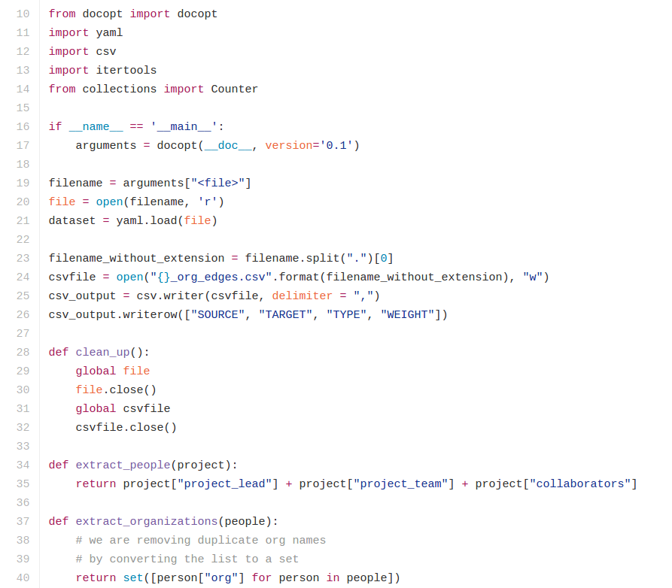
Example of Python script
DRAFT

Slide 9
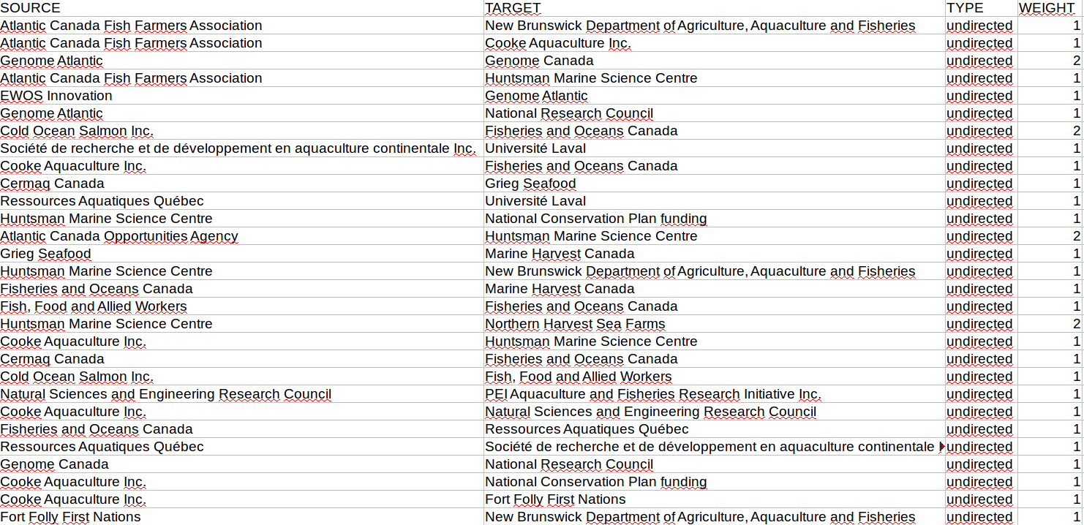
Example of a csv file
DRAFT

Slide 10
Results
In 2015, a total of 215 projects were included in the Canadian Aquaculture R&D Review of which 168 (78%) were collaborative, i.e. involved two or more organisations
In 2015, Fisheries and Oceans Canada was involved in 138 (64%) of the 215 projects of which 108 (78%) were collaborative
DRAFT

Slide 11
2015 Canadian Aquaculture R&D Community
168 projects
203 nodes
616 edges
Density: 0.03
Degree range: 1 to 129
Average degree: 6
Edge weight: 1 to 12
DRAFT

Slide 12
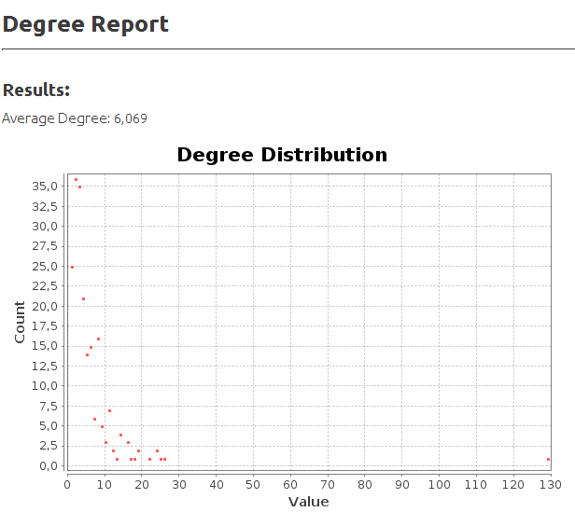
DRAFT

Slide 13
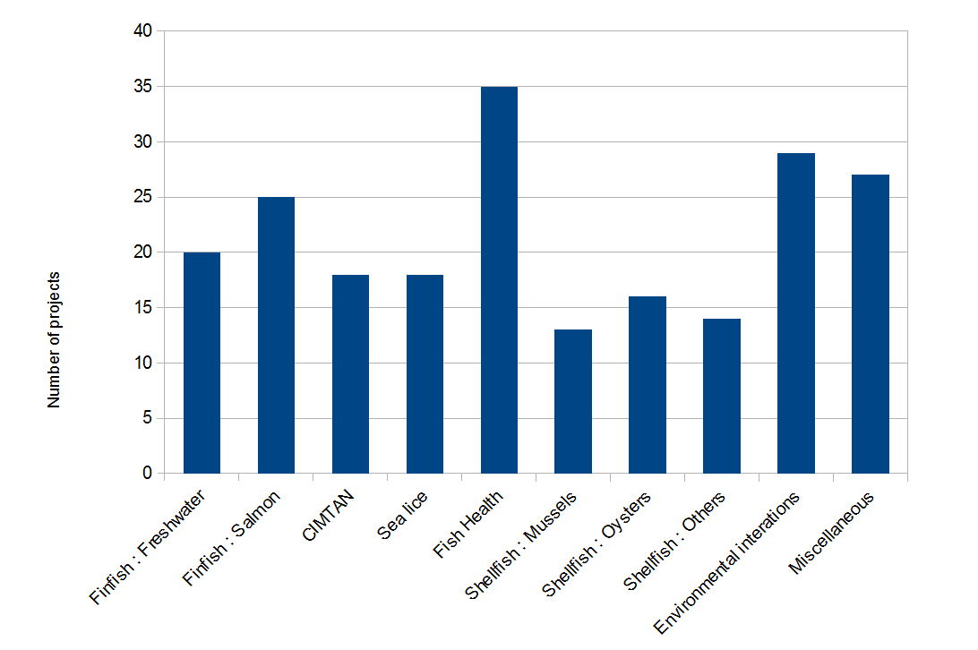
2015 Aquaculture R&D Review
DRAFT

Slide 14
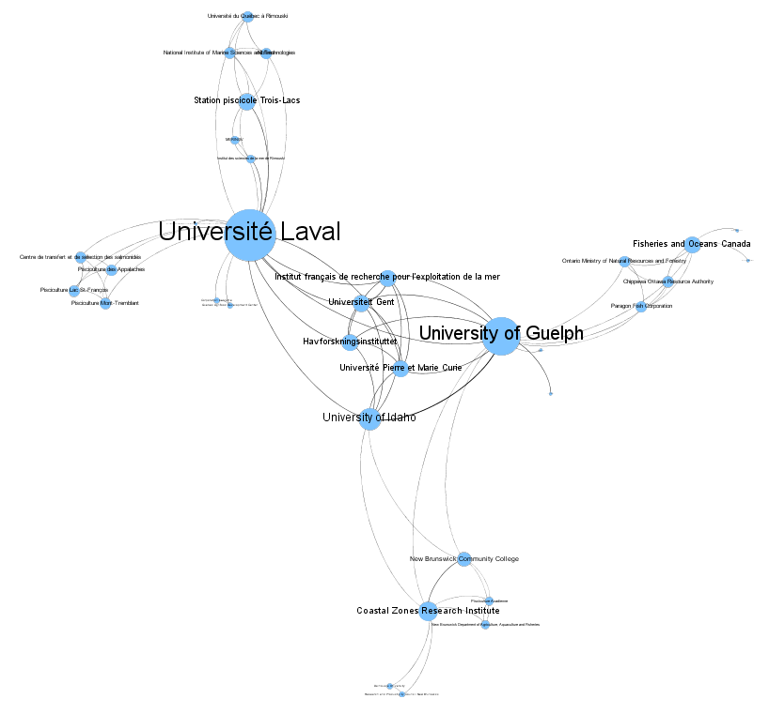
Finfish: Freshwater
20 projects
36 nodes
78 edges
Density: 0.12
Degree range: 1 to 19
Average degree: 4
Edge weight: 1 to 3
DRAFT

Slide 15
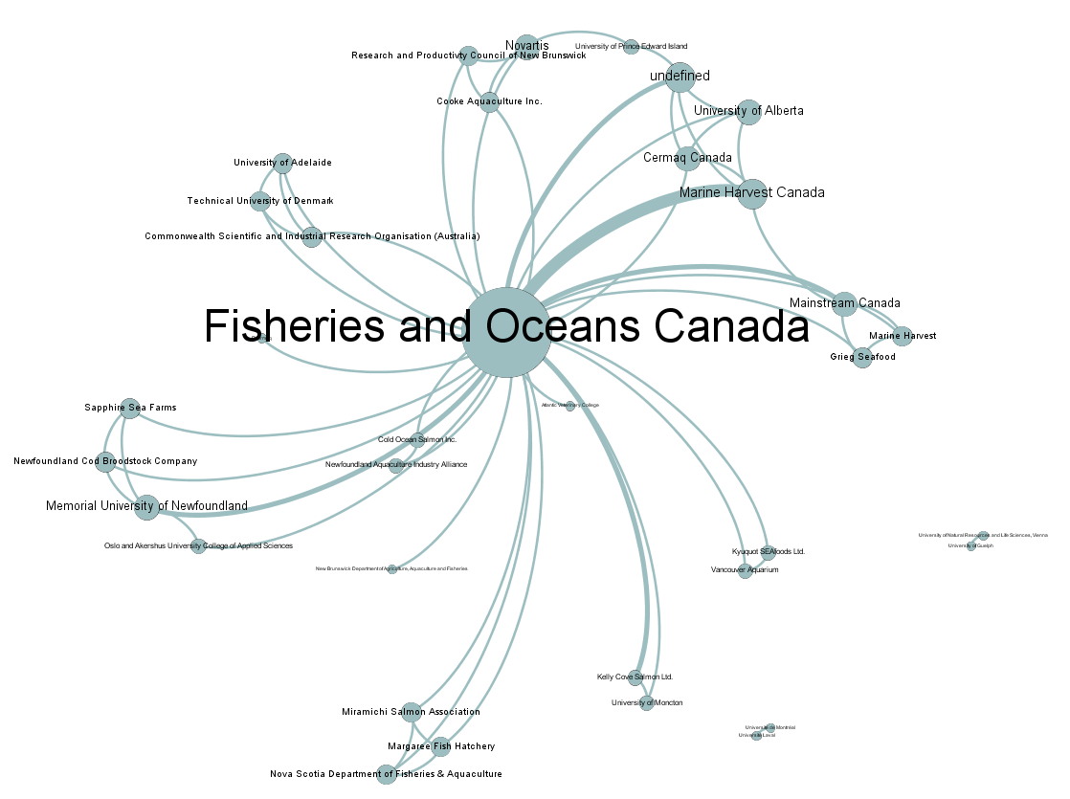
Fish Health
35 projects
35 nodes
59 edges
Density: 0.10
Degree range: 1 to 29
Average degree: 3
Edge weight: 1 to 5
DRAFT

Slide 16
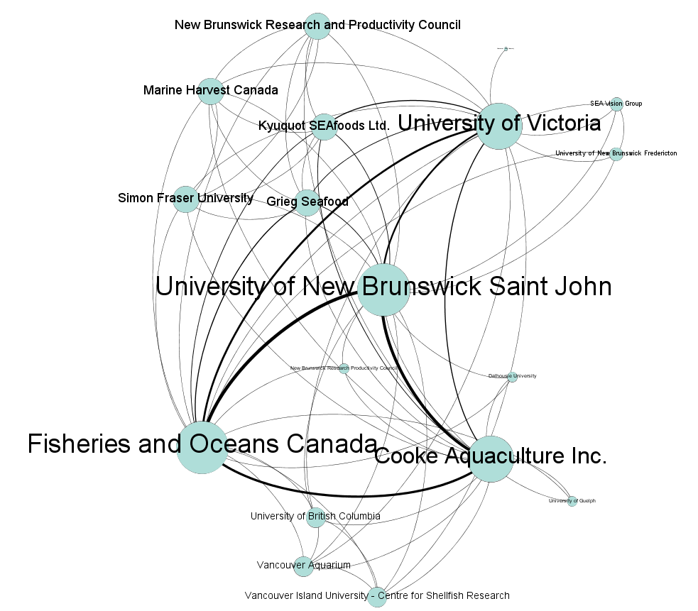
CIMTAN
18 projects
18 nodes
68 edges
Density: 0.44
Degree range: 1 to 16
Average degree: 7
Edge weight: 1 to 10
DRAFT

Slide 17
Conclusions
In 2015, 78% of aquaculture R&D projects in Canada were collaborative
  The structure and density of the networks varies significantly among different research areas
In 2015, DFO was an central node in the Canadian aquaculture R&D network being involved in 64% of collaborative aquaculture R&D projects
  DFO’s position varies among networks of different research areas
DRAFT

Slide 18
Discussion
Increasing collaboration = more edges
  How many edges is enough?
    What is the targeted rate of scientific collaboration in aquaculture?
  Where should new edges be added?
    With DFO? Should DFO collaborate on more projects? This would increase DFO’s centrality measure
    Between partners? Should there be more collaboration between organisations other than DFO? This would decrease DFO’s centrality measure
DRAFT

Slide 19
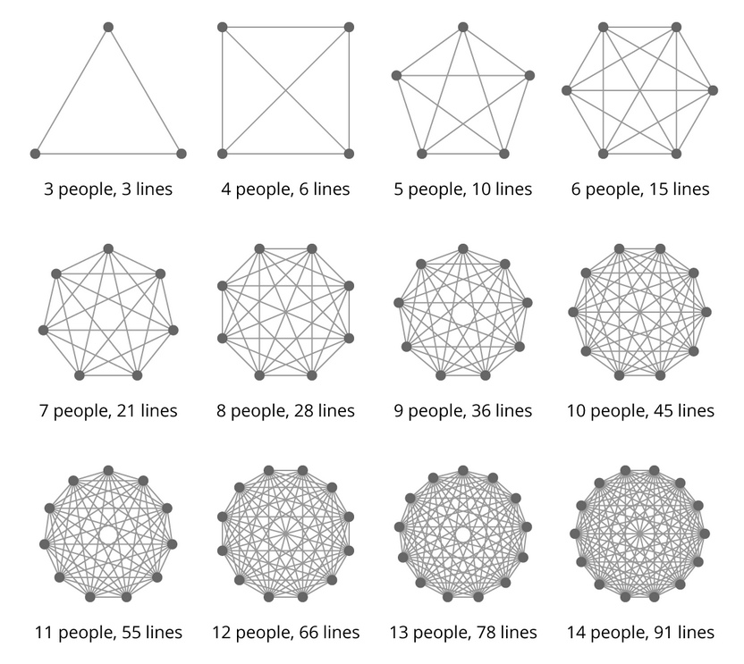
Is more always better?
Image reproduced from: https://stackoverflow.com/questions/984885/
how-do-i-explain-the-overhead-of-communication-between-developers-in-a-team
DRAFT

Slide 20
Potential future analyses
Determine how aquaculture R&D networks change over time
Determine if increased collaboration correlates with increased valuable outcomes such as publications, science advice, patents, etc.
Determine the optimal structure of scientific collaboration (cost vs. outcomes)
Analyse structures of funding networks
DRAFT

